Slide 1

BARNES & NOBLE
Presented By:
Shubham Dwivedi
Vamshidhar Nandineni
Nunayon Avoseh
Apeksha Suram

Slide 2


Business Model
Barnes & Noble is a retail bookstore chain that offers a broad range of physical and electronic books through various channels, including physical stores, an online store, and digital reading devices.
PHYSICAL BOOKS
SUPPLIERS
E-BOOKS
INFRASTRUCTIRE
NOOK DEVICE
OPERATIONAL COST

Slide 3
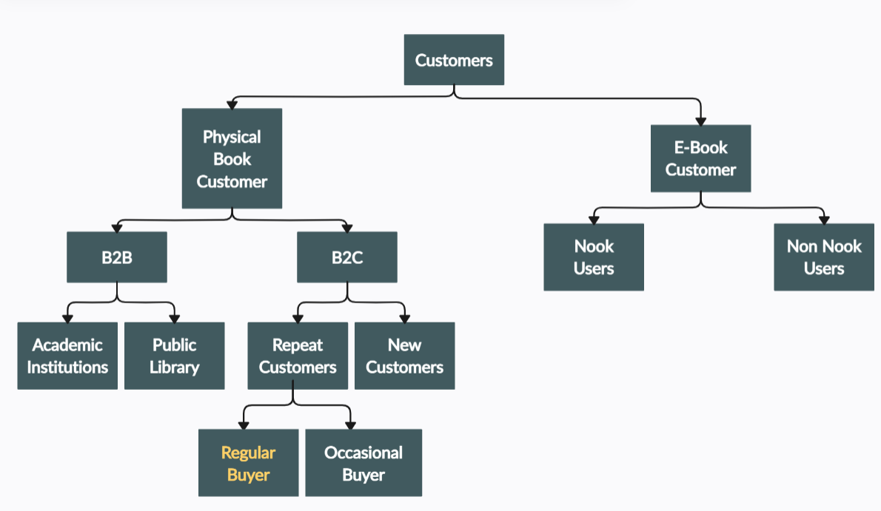
Customers

Slide 4
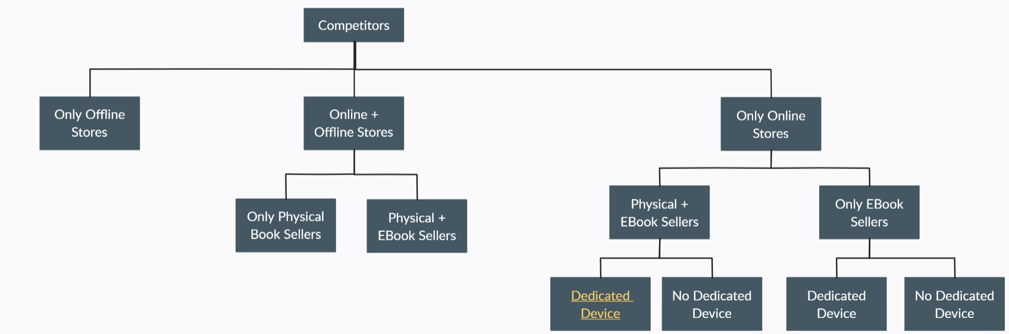





Competitors

Slide 5
Suppliers
Publishers
High Revenue Generators (Bestsellers) (60%).
Medium Revenue Generators (30%).
Low Revenue Generators (10%).
Exclusive Publishers
Technical Suppliers
Hosting Services
App Stores
Electronics parts suppliers
Infrastructure Suppliers
Logistic Supplier

Slide 6
Substitutes New Entrants
National retail stores selling books as well.
Some new device independent ebook reader format.
Audiobooks.

Slide 7
Challenges
Decline in physical book’s market share.
Ebooks consuming physical book’s market share.
Lack of experience in technology and hardware field.
Fierce pricing competition with their rivals.
Lack of multiple revenue channels.

Slide 8
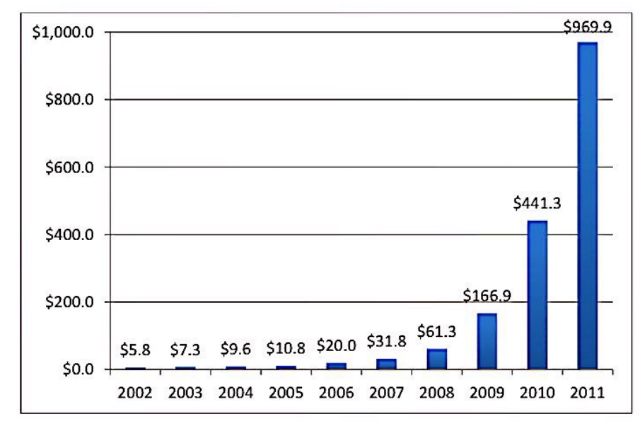
Importance of E-book for Publishers
PROS | CONS
Low production and inventory cost. | Restricted customer base.
Improved availability and enhancement of the books. | Device and format compatibility.
No geographical barriers | Piracy.
Creates a new revenue channel. | Heavy discounts by E-Book retailers
Conclusion: With the increase in technology and change in customer behaviour,
and their major customers who are the leading retailers are also focused on the development of e-book industry
it is important for Publishers to get adapted to E-book industry.

Slide 9
Role of Publishers
Controls the availability of E-Books.
Can regulate book pricing.
Should take care of copyrights.
Responsible for content formatting.

Slide 10
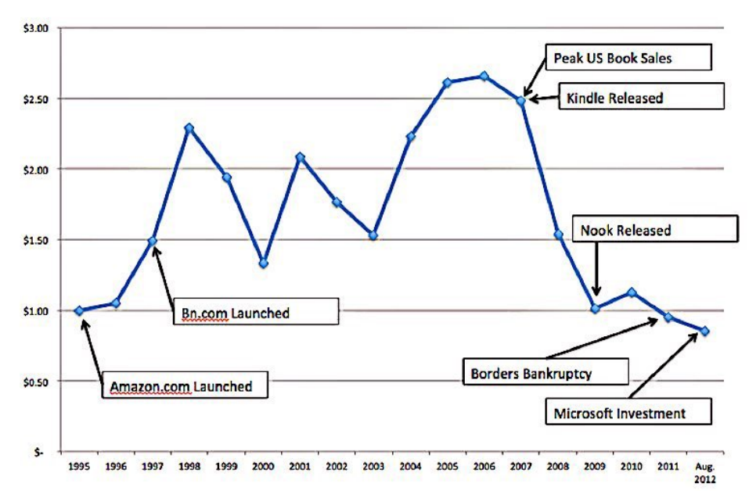
Importance of Dedicated Device
Pros | Cons
A new revenue channel. | No prior experience.
To stay in the Ebook competition. | Format compatibility issues.
To retain existing customer base. | High R&D expenses.
The sales went down 14% from 2008 to 2009, when Amazon launched kindle.
To stay in the market and keep up sales B&N launched Nook which increased their sales by 31%.

Slide 11
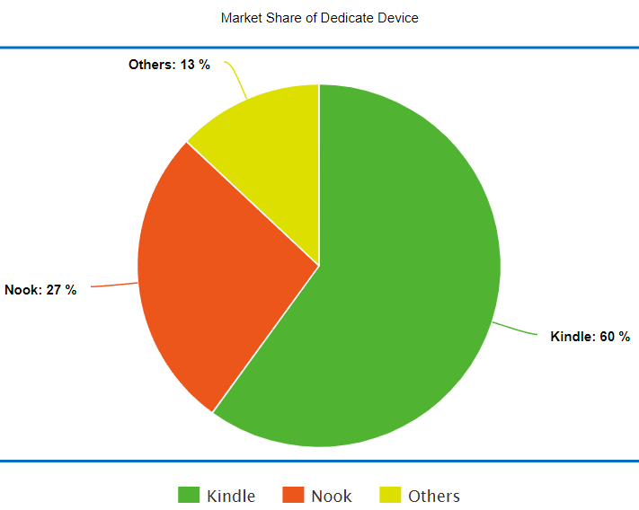
Nook is prone to failure
Barnes & Noble lacks experience in producing hardware devices.
Competitor's devices were more technologically sophisticated.
Trend moving towards tablets over reading devices.
Long-term decreasing profit margin after Nook’s release.

Slide 12
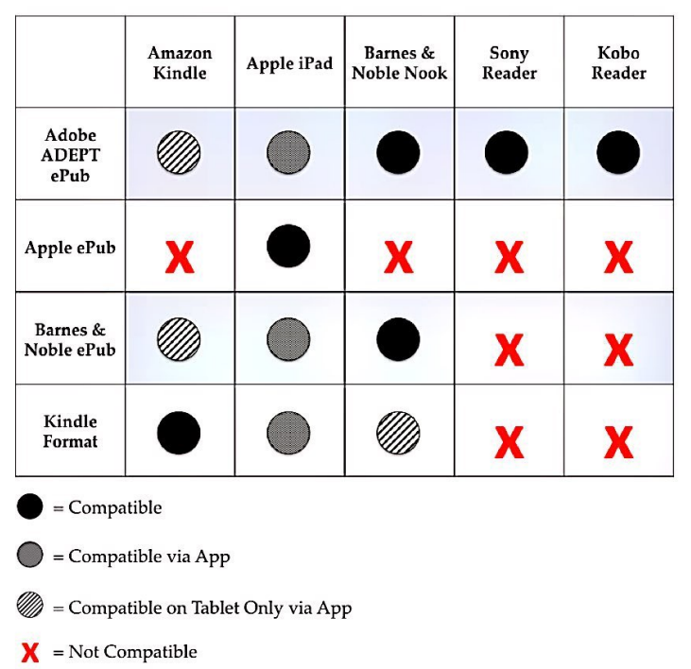
Strategies if Nook fails
Adopt a more compatible format like Adobe ePub.
Leverage the Ebook library to collaborate with a prominent electronics firm like Samsung.
Start a subscription plan.

Slide 13
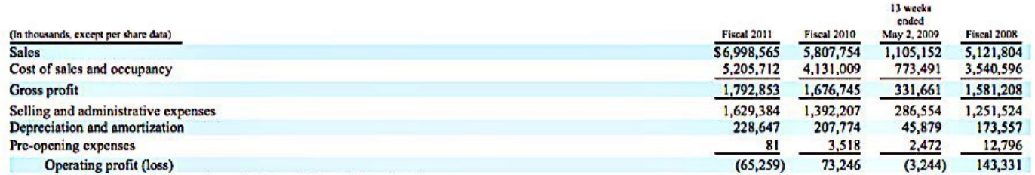
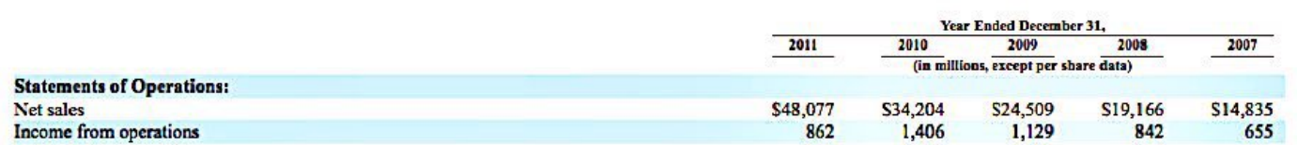
B&N’s Response
Restrain from a price competition for eBooks with Amazon.
B&N should concentrate on physical book retailing business.
Decreasing Asset : Liability ratio from 2010 to 2011 from 2.14 to 2.07.
Barnes & Noble
Amazon

Slide 14

Additional Recommendations
Start a membership subscription plan.
Make payment to publishers in installments to earn interest rate.
Using AB testing, organize in-store author meet ups.
Using platform independent eBook format.

Slide 15
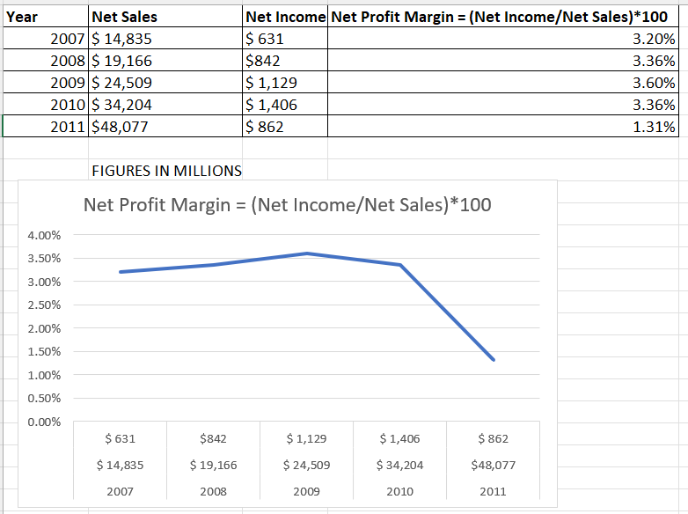
Amazon’s Heavy Discounting
Gives heavy discounts despite suffering losses.
Has multiple revenue channel to regulate cash flow.
Displays advertisements on kindle.
Amazon spending more as compared to earning in 2011 than previous years

Slide 16
Future Single Winner?
Yes (Amazon) | No
Already has 60% of dedicated device market share. | Rise of platform independent eBook reader format.
Has multiple revenue channels to bear discounting losses. | Increased competition in multifunction tablet devices.
Lock in users by not supporting other formats. | New entrants like audio book can disrupt the market.
Conclusion:
There won’t be a single winner after 5 years.
Amazon will have a large yet declining market share.
Firms like Apple and Google will increase their market share.

